Slide 1
Crime Mapping Framework for Open Data
Michael Crowder
Lauren Darr
Gerardo Garza
Brent Allen

Slide 2
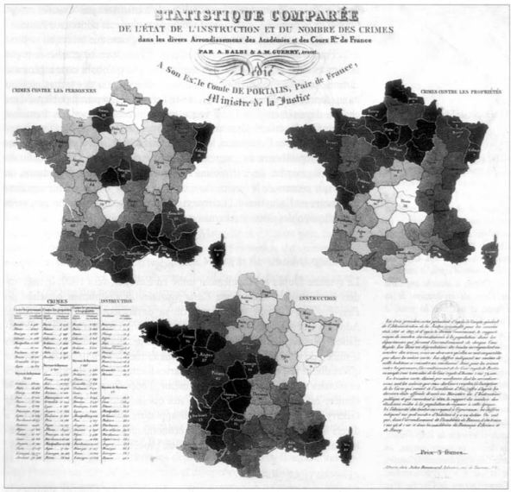
Crime Mapping
1830s Guerry maps crime rates and education in France
Birth of criminology and sociology
1990s crime mapping goes digital
Police adoption of digital maps remains complicated

Slide 3
Crime Mapping
Law Enforcement Agencies
That’s around 20 people to run
911 Operators
Dispatchers
Forensics
Mechanics
HR
Finance
https://www.bjs.gov/content/pub/pdf/lpd13ppp.pdf

Slide 4
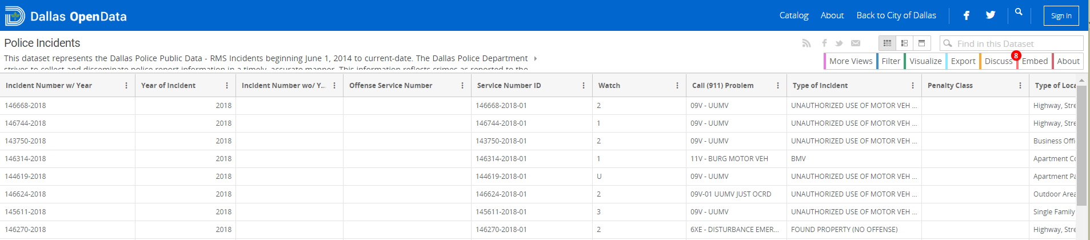
Open Data
Is open data really open at all?
Yes and No
Does the public know what or how to use:
Comma-separated values (.csv)
JavaScript Object Notation (JSON)
Application Programming Interface (API)
Does a giant data table engage the public?

Slide 5
Motivation
Three part:
New national standard for crime reporting called NIBRS (National Incident-Based Reporting System)
No current standards for geographical visualization of NIBRS data for the public
Smaller agencies are less likely to have the resources to provide information to citizens

Slide 6
Motivation
National Incident-Based Reporting System
New crime reporting standard starting in 2021
Allows up to 10 offenses per incident
Higher level detail on less serious crimes
Goals:
Enhanced quantity, quality, timeliness of crime data
Improved compiling, analyzing, auditing, and publishing

Slide 7
Motivation
National Incident-Based Reporting System
New crime reporting standard starting in 2021
Allows up to 10 offenses per incident
Higher level detail on less serious crimes
Goals:
Enhanced quantity, quality, timeliness of crime data
Improved compiling, analyzing, auditing, publishing

Slide 8
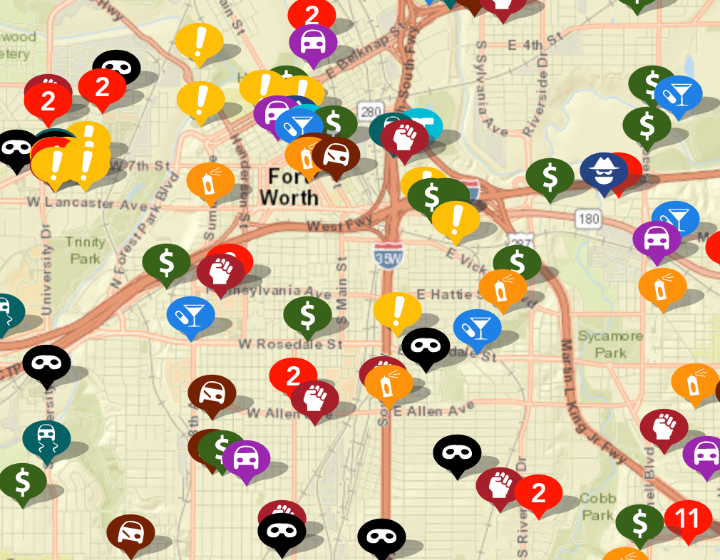
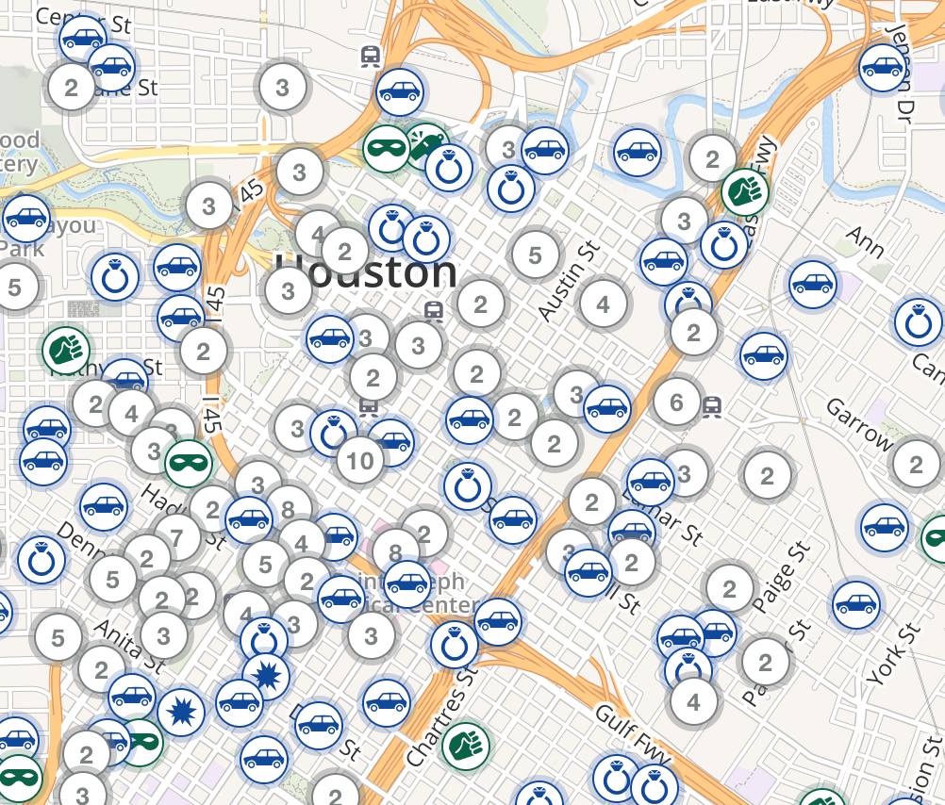
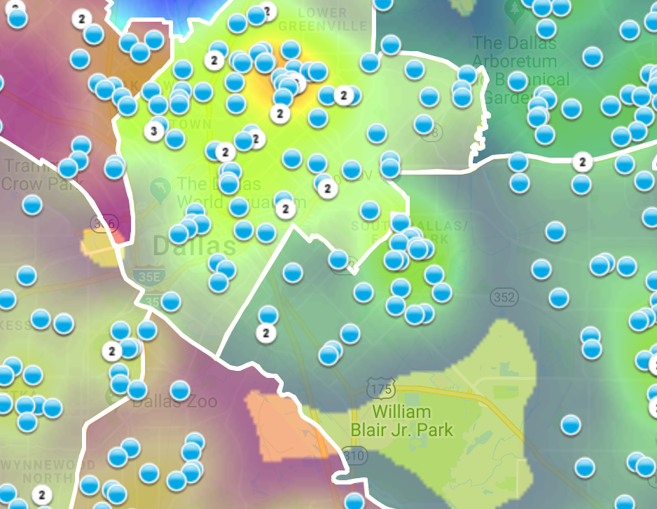
Motivation
No LEA standards for crime mapping:
Crime maps published by assortment of groups
Data source can be unclear
Variety of design features and quality
https://www.crimemapping.com/
https://www.crimereports.com
https:www.cityofirving.org

Slide 9
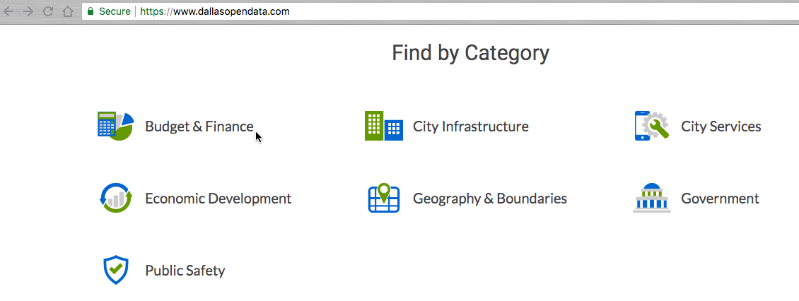
Data Source
Data source
City of Dallas Open Data Portal
Police Incident Data
Example variable- burglaries
Ability to segment
Not an overwhelming number like breaking into cars
Notes:
Data Source
Our data source is the city of Dallas Open Data Portal
Contained within the public safety section is a dataset called “Police Incident Data”
This data contains around 400K records
103 Columns
Mainly between the years of 2015 to today.
Our mapping focusses on burglaries
Burglary gave us an ability to segment
Residential
Commercial (Business, Government, Health etc)
Not an overwhelming number like vehicle break-ins, or a low number of activity like violent crimes.

Slide 10
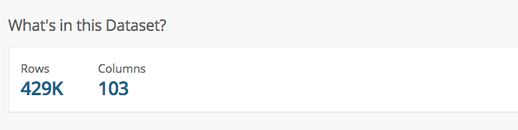
Data Source
Data source
City of Dallas Open Data Portal
Police Incident Data
Our mapping focuses on burglaries
Ability to segment
Not an overwhelming number like breaking into cars
Notes:
Data Source
Our data source is the city of Dallas Open Data Portal
Contained within the public safety section is a dataset called “Police Incident Data”
This data contains around 400K records
103 Columns
Mainly between the years of 2015 to today.
Our mapping focusses on burglaries
Burglary gave us an ability to segment
Residential
Commercial (Business, Government, Health etc)
Not an overwhelming number like vehicle break-ins, or a low number of activity like violent crimes.

Slide 11
Map Making
Mapping handled through open-source products
R
Leaflet – Open-source JavaScript library

Slide 12
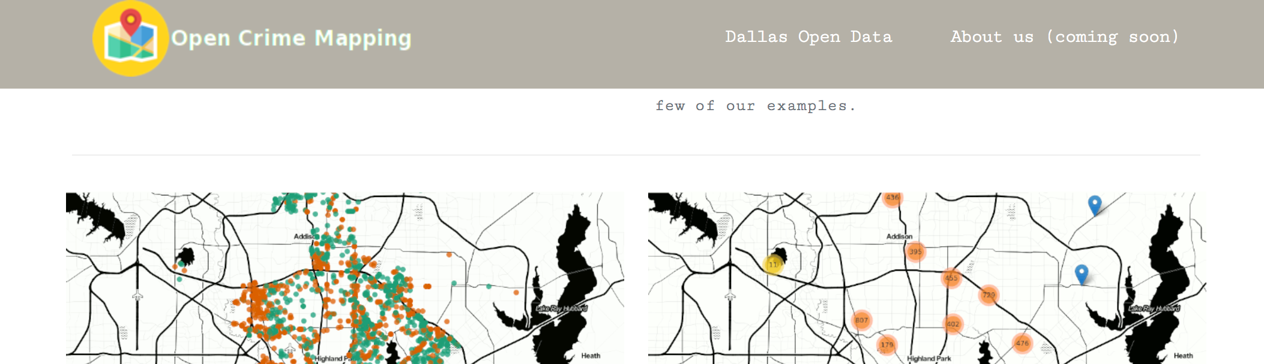
Our Solution
Opencrimemapping.org
Displays our framework as an operating model
Shows map makers how choice in certain features can take potential knowledge away from a user.

Slide 13
Geovisual Framework
Interactive
Time-bound
Base-map
Limited variable(s)
Color scheme
Map Types

Slide 14
Interactivity
Cartographic Interaction
The use of a digital map by a user facilitated by a computer.

Slide 15
Interactivity
Interaction with maps allows users to explore scenes dynamically
Ability to vary scenes with changing scale and location spatially.
Enhanced user engagement leads to learning and understanding.

Slide 16
Interactivity
Interaction with maps allows users to explore scenes dynamically
Ability to vary scenes with changing scale and location spatially.
Enhanced user engagement leads to learning and understanding.

Slide 17
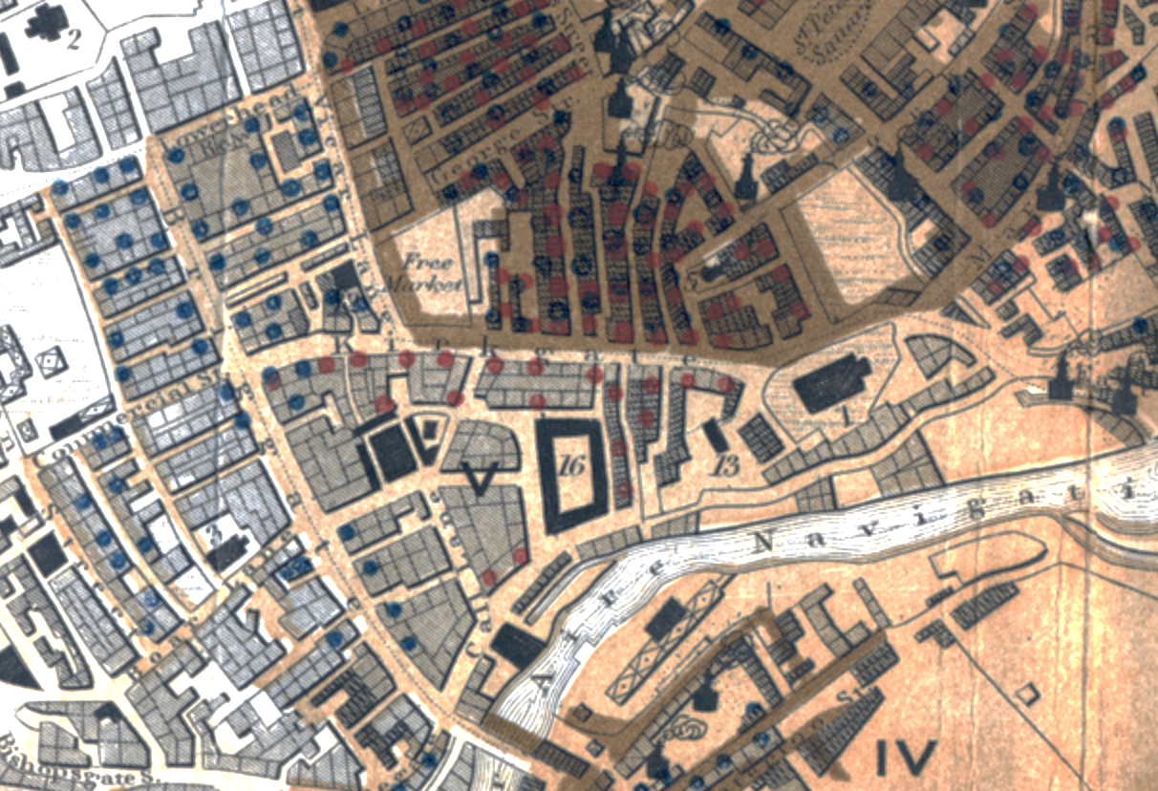
Color
The goal of color in a map is to give a clear visual indication of what is happening on the earth.
“Sanitary Map of the Town of Leeds” 1842
Blue dots are cholera
Orange dots are other contagious diseases

Slide 18
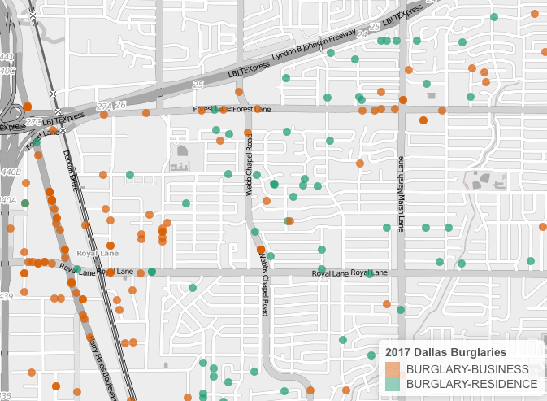
Color
Graphically showing the difference between entities by using color
Dot map at opencrimemapping.org

Slide 19
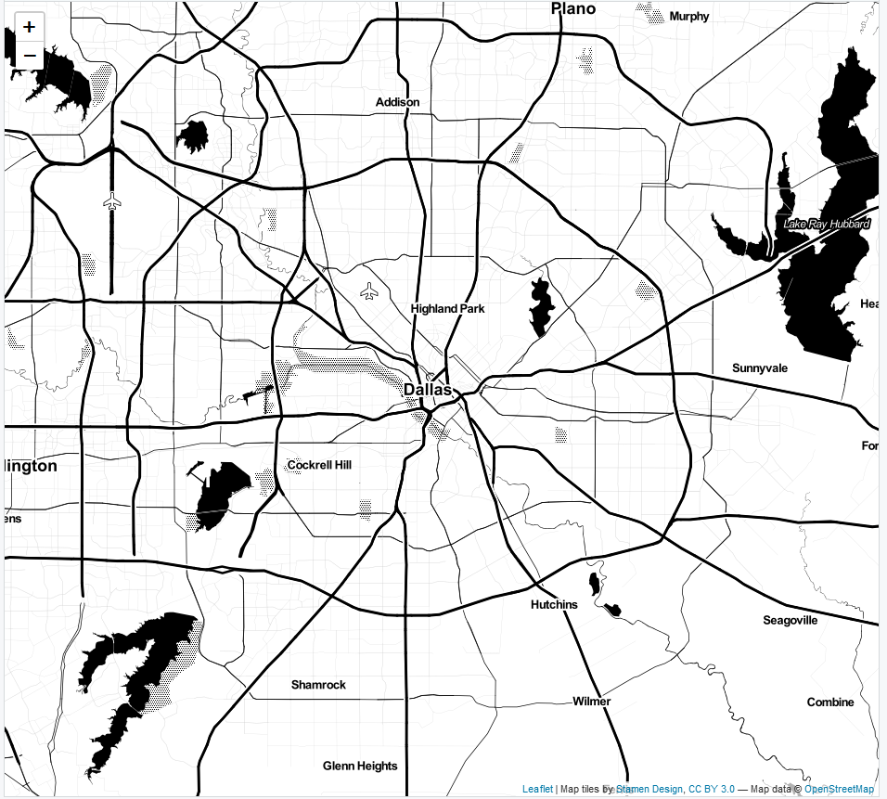
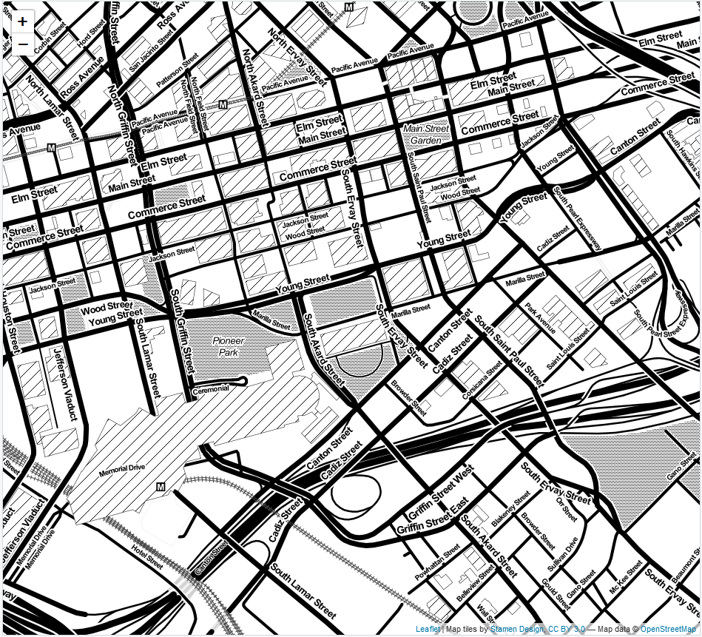
Basemaps
Zoom: ‘11’
Zoom: ‘16’
Leaflet, 3rd party, or custom map tiles
Landscape of chosen design and detail
Layering capability
2-lines of code

Slide 20
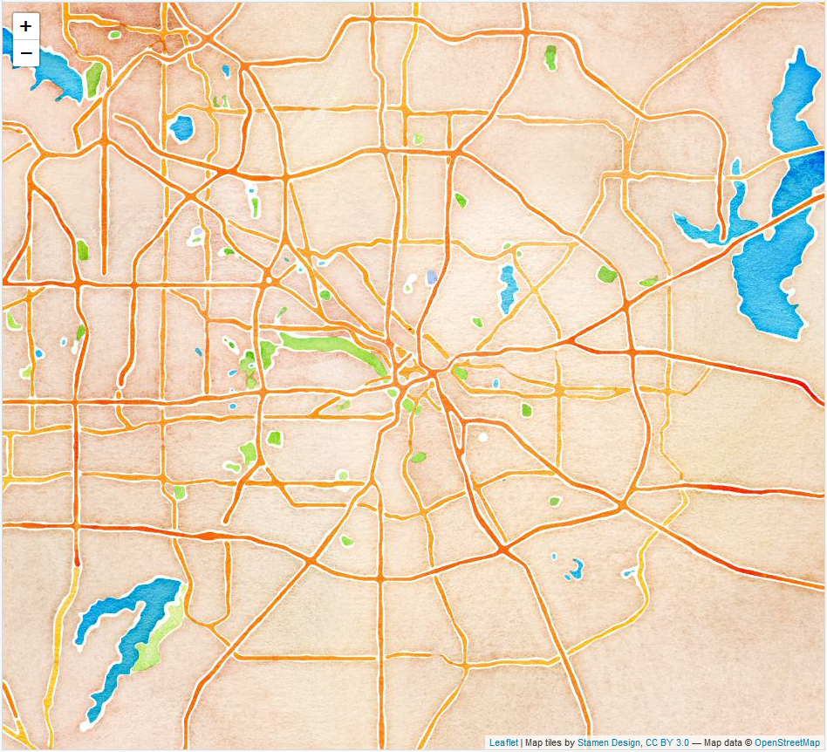
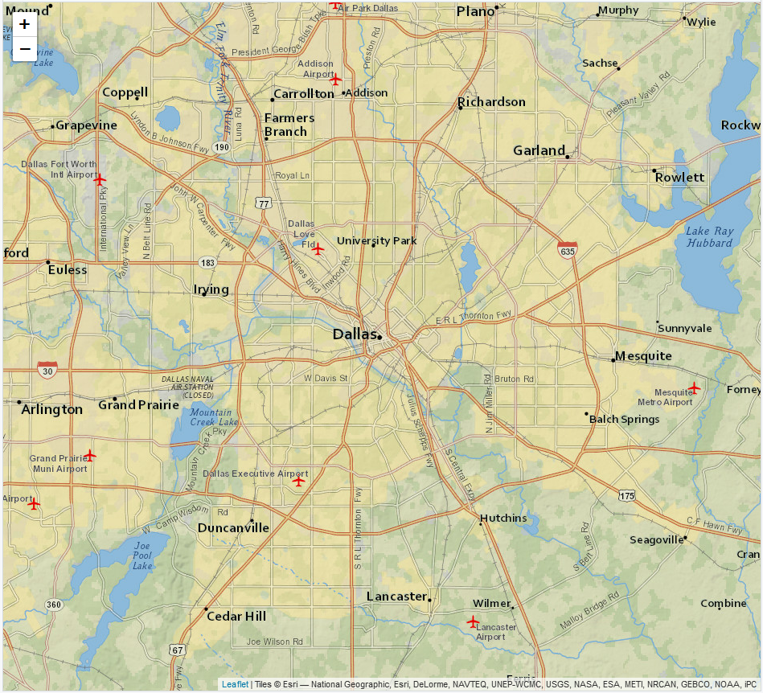
Basemaps
Artistry v. Clarity
Watercolor
Zoom: ‘11’
NatGeo
Zoom: ‘11’

Slide 21
Map Types
Dot Map
Discrete, multiple variables
View of landscape
Dot size can be misleading
Opacity for density

Slide 22
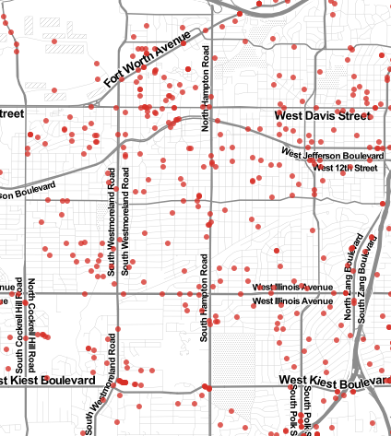
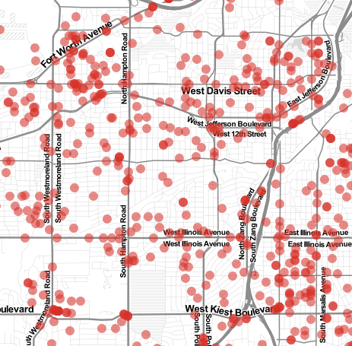
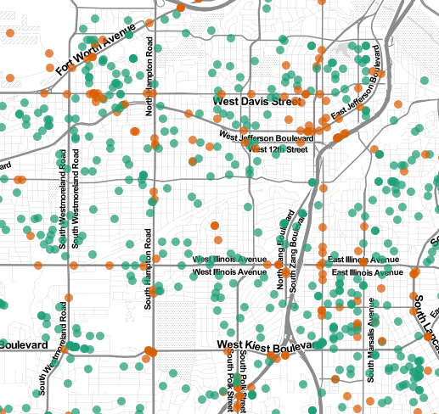
Map Types
Dot Maps at the same scale different dots
Small Dots
Large Transparent Dots
Multiple Variables

Slide 23
Map Types
Cluster Map
Solution to densely populated dot map
Mouse over feature shows captured area
‘Spiderfy’ shows individual markers on close up
Computationally more efficient than dot

Slide 24
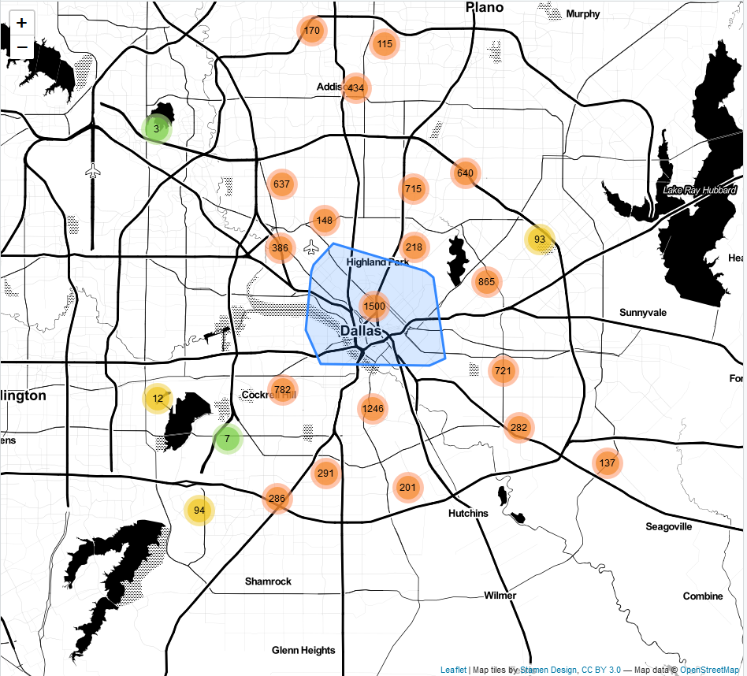
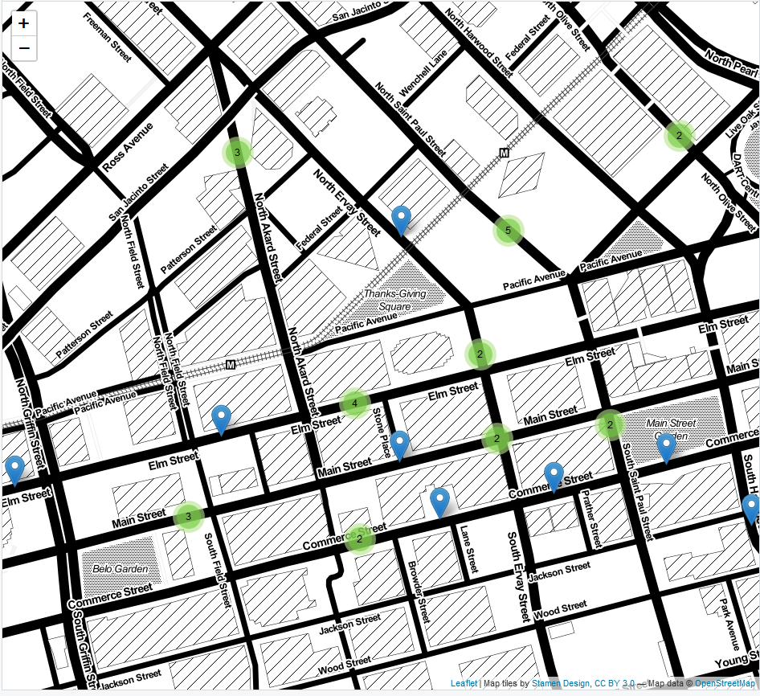
Map Types
Cluster Map
Mouse Hover
Zoom: ‘11’
2 Cluster Zoom
‘Spiderfy’ markers

Slide 25
Map Types
Heat Map
Density, higher level view
Single variables

Slide 26
Map Types
Heat Map
*Map examples

Slide 27
Time Bound
Victims, offenders, managers of property adjust their densities over time
Comparisons of density over time
Year over year
Month over Month
Etc.

Slide 28
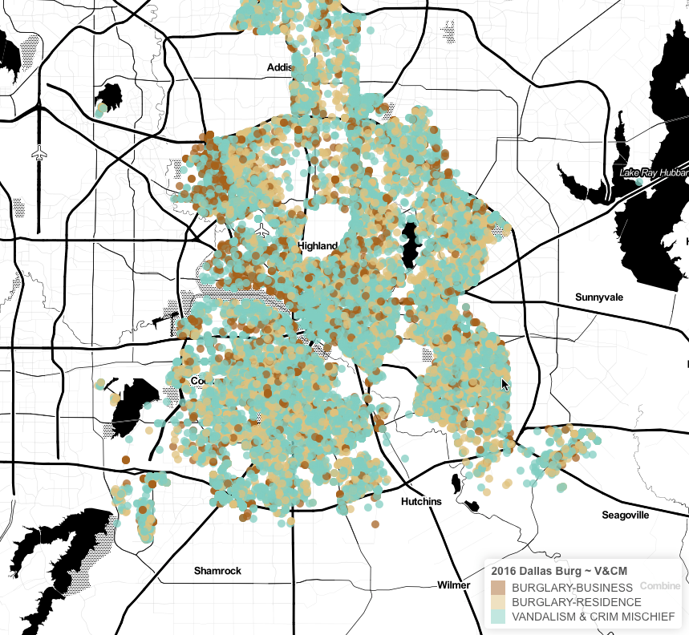
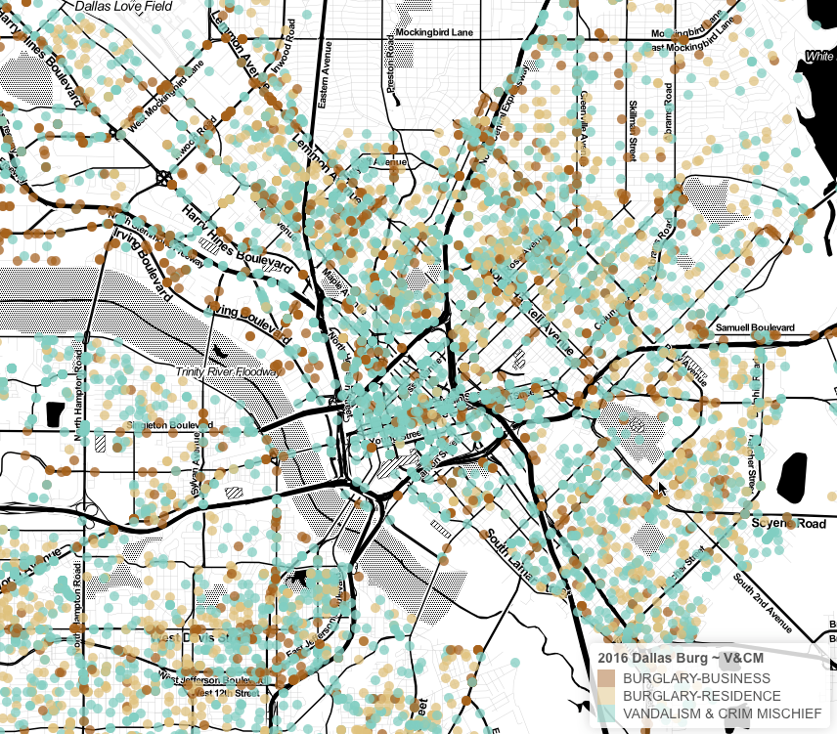
Variable Selection
Increasing the number of incident types can make a map too busy.

Slide 29

Ethical Considerations
The map creator has the ability influence public opinion depending on map type.
The person who reported the incident has their name and address in the dataset.

Slide 30
Ethical Considerations
The map creator has the ability influence public opinion depending on map type.
The person who reported the incident has their name and address in the dataset.

Slide 31
Deployment & Conclusion
Website deployment
Demonstration of a simple website with a limited number of maps
Opencrimemapping.org

Slide 32
Deployment & Conclusion
Infrastructure for the design and use of maps for crime display could lead to increased communication between police and citizens and thus improve quality of service and reputation.

